Slide 1


Salt Lake City
August 7th 2020 - Salt Lake City US
YFA-project
Virgile Colrat – weekly update
Department of Electrical and Computer Engineering – University of Utah

Slide 2
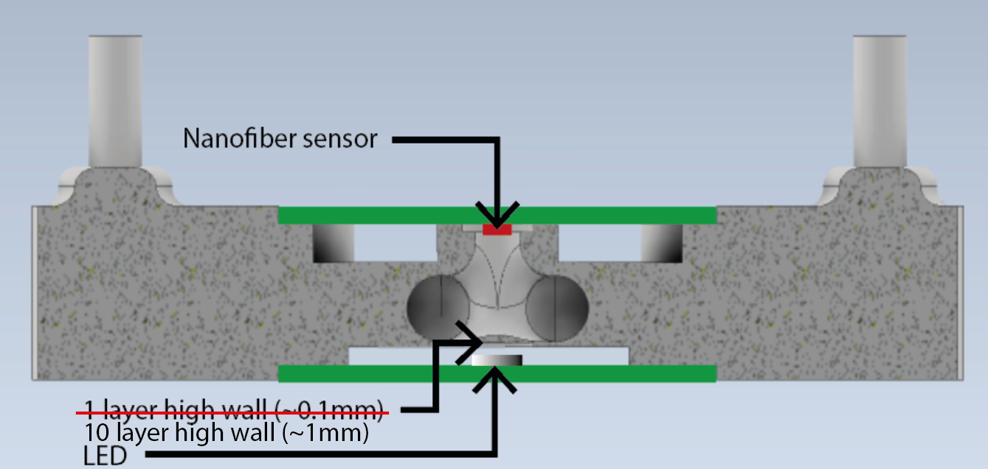
Update – Housing
New design of the housing to accommodate the LED for sensor illumination
The housing is now sandwiched between the LED PCB and the sensor PCB
The wall between the LED and gas line has been thickened to eliminate leaks but still be semi-transparent

Slide 3
Update - LED Polarization
The LED is drived at constant voltage (2.3V)
LED in Vaporsens’s pilot uses PWM polarization but requires to trigger the measure at the ’’right’’ time. In the future, I could add a microcontroller generating the PWM
The table below show the response of the sensors for the sensors polarized @7V and placed in the housing described in the previous slide. The LED is polarized @2.3VDC. The testing is conducted @21.2°C, 25.3%RH
Sensor Ref. | Current measured (Vaporsens) | Current measured (LNIS)
054 | 1.98nA | 3.575nA
076.1 | 10.27nA | 18.058nA

Slide 4
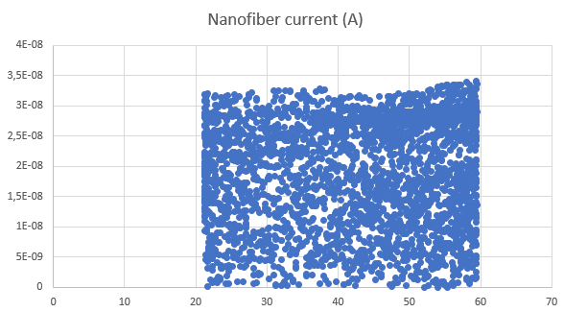
Update – Impact of T° on sensor response
This test is attempt to see if the response of the sensor depends on the temperature. The temperature varies from 21.2°C to 59.4°C (humidity varies from 25.3 @21.2°C to 5.5°C @59.4°C)
For each temperature, between 15 to 20 sensor measuring points are taken. The figure shows the sensor response throughout the entire temperature sweep. The figure shows that the response does not vary with temperature as the density is uniform across the temperature range

Slide 5
Update – Chemicals sensor testing
I am waiting for the regulator for the ammonia cylinder to begin testing the ammonia sensor
I am still waiting for the permeation oven to be ready on Vaporsens side to test the acetic acid sensor
Vaporsens apparently does not have any data showing the effect of humidity or temperature on the sensor response

Slide 6


Laboratory for NanoIntegrated Systems Department of Electrical and Computer Engineering MEB building – University of Utah – Salt Lake City – UT – USA
Thank you for your attention
Questions?

